Slide 1
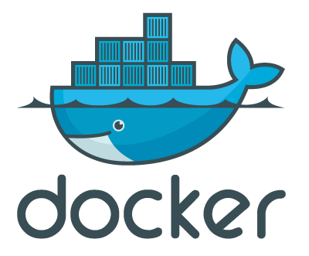
Basic Docker 101 (by Entronica)
Chantatha Polsamak (chay)
Senior Software Developer
chantatha.p@entronica.co.th

Slide 2
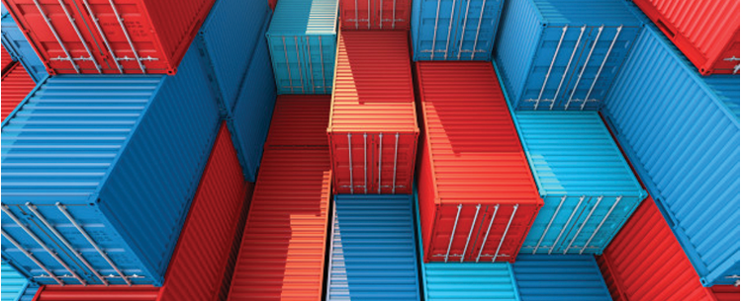
What is Docker?
Wikipedia defines Docker as
an open-source project that automates the deployment of software applications inside containers by providing an additional layer of abstraction and automation of OS-level virtualization on Linux.

Slide 3
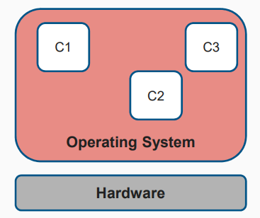
What are containers
Server-virtualization
Multiple isolated user-space instances (instead of one) on a single kernel of the operating system
Separate out a user instance from another
Also called software containers, jails

Slide 4
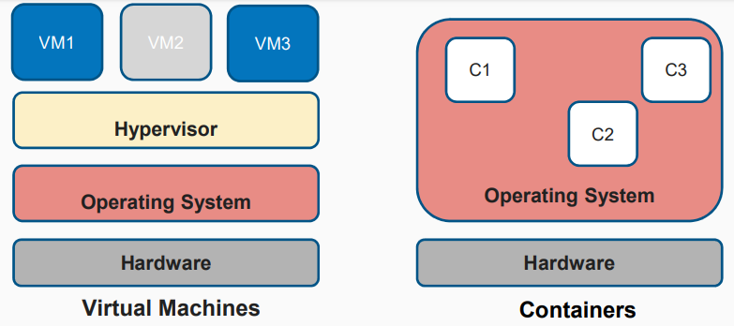
How are containers different from VMs

Slide 5
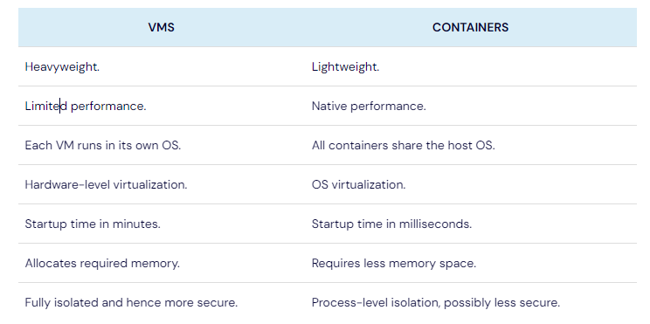
How are containers different from VMs

Slide 6
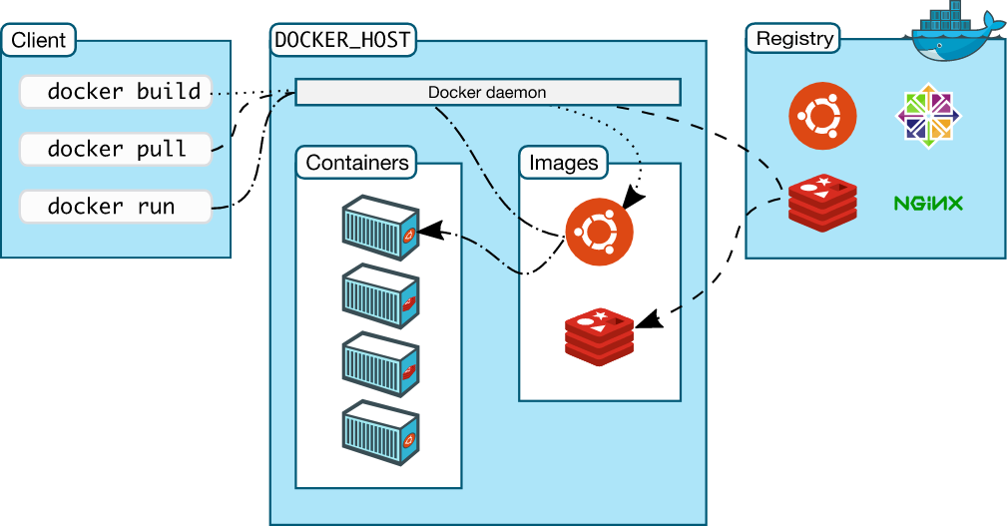
Docker architecture

Slide 7
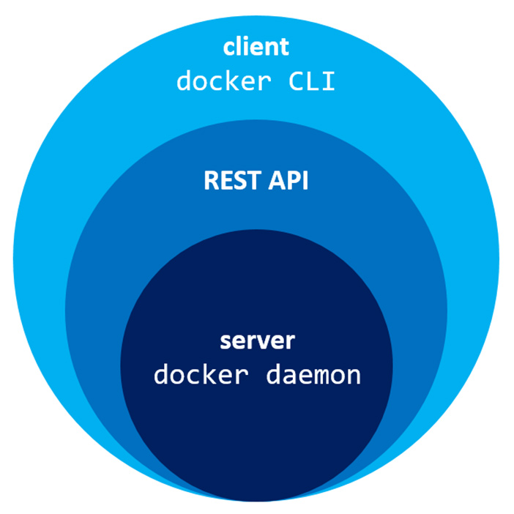
The Docker daemon
The Docker daemon (dockerd) listens for Docker API requests and manages Docker objects such as images, containers, networks, and volumes. A daemon can also communicate with other daemons to manage Docker services.

Slide 8
Docker registries
A Docker registry stores Docker images. Docker Hub is a public registry that anyone can use, and Docker is configured to look for images on Docker Hub by default. You can even run your own private registry.
When you use the docker pull or docker run commands, the required images are pulled from your configured registry. When you use the docker push command, your image is pushed to your configured registry.

Slide 9
Docker objects
Images
Containers
An image is a read-only template with instructions for creating a Docker container. Often, an image is based on another image, with some additional customization. For example, you may build an image which is based on the ubuntu image, but installs the Apache web server and your application, as well as the configuration details needed to make your application run.
A container is a runnable instance of an image. You can create, start, stop, move, or delete a container using the Docker API or CLI. You can connect a container to one or more networks, attach storage to it, or even create a new image based on its current state.

Slide 10
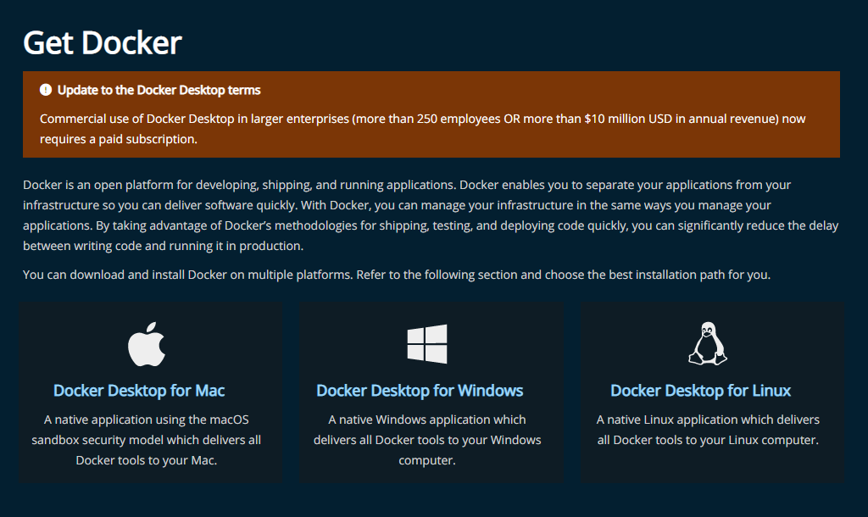
Download and install
Get Docker | Docker Documentation

Slide 11
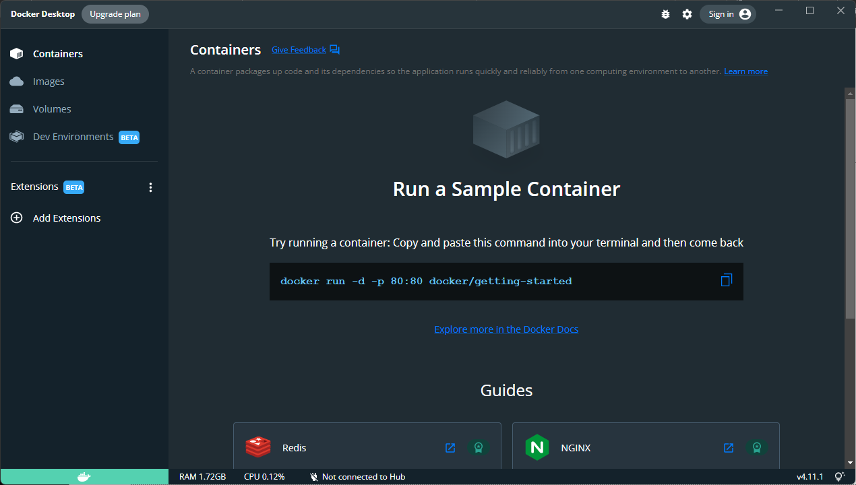
Get Docker

Slide 12
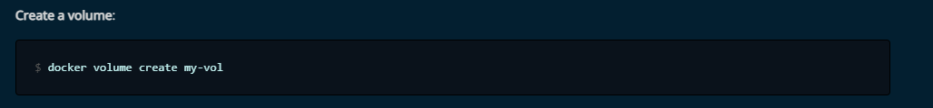
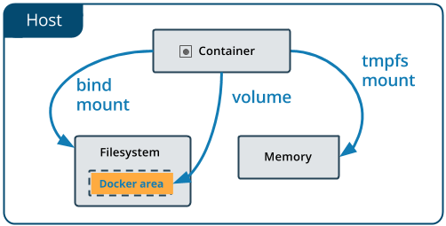
Docker Volumes
Volumes are the preferred mechanism for persisting data generated by and used by Docker containers. While bind mounts are dependent on the directory structure and OS of the host machine, volumes are completely managed by Docker.

Slide 13
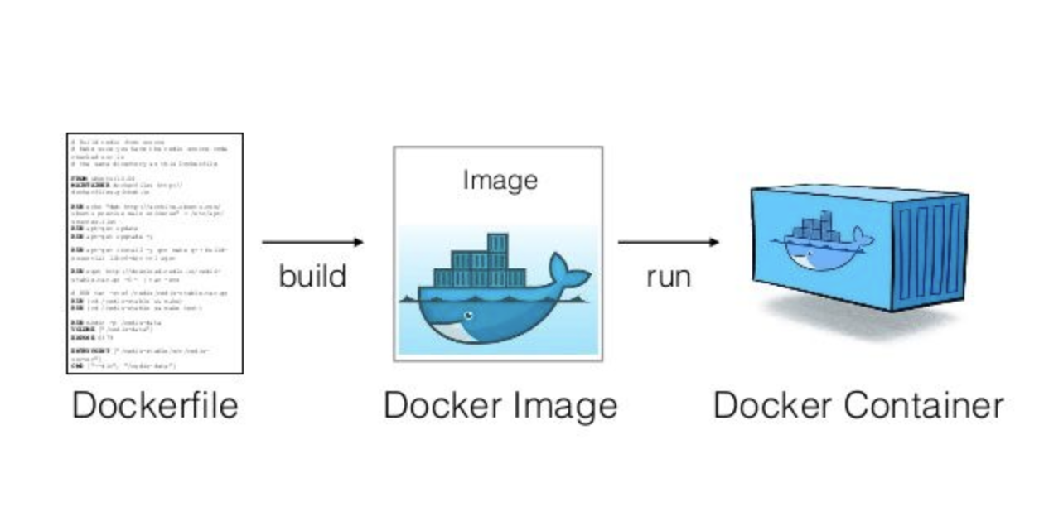
Dockerfile
Docker can build images automatically by reading the instructions from a Dockerfile. A Dockerfile is a text document that contains all the commands a user could call on the command line to assemble an image. Using docker build users can create an automated build that executes several command-line instructions in succession.

Slide 14
Docker build
docker build -t myimage .

Slide 15
Docker run
docker run -dit -p 3000:80 --name testMyImage myimage

